Slide 1
Essence Introduction
- The SEMAT Initiative
Kim Horn
Version 1.0
1 August 2018
Copyright Notice, material in this pack:
Essence material is property of Ivar Jacobsen International and Semat.org

Slide 2
Agenda
Part 1
Process Vs Practices
Semat & Essence
Kernal
Concerns
Alphas
State
Checklists
Cards
Practical Use
Drive Iterative development
Part 2
Practical Use Continued
Retros
Reviews
Organising Lifecycles
More than Alphas
Activity Spaces, Activities
Competencies
Practices
Agile Essentials
Architecture Essentials
Web Tooling
Competencies

Slide 3
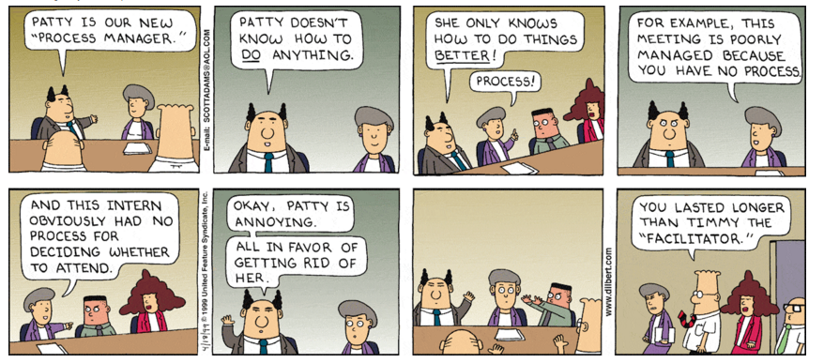
Process

Slide 4
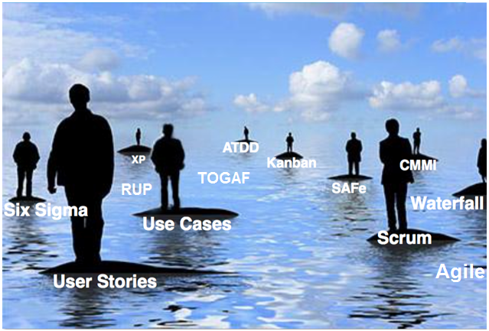
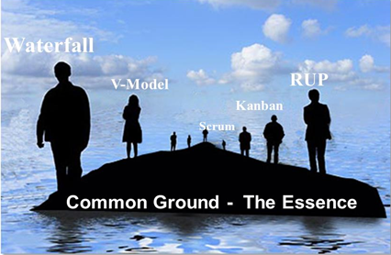
Where are we with software development ‘Processes’ ?
Everyone of us knows how to develop our own software, but as a community we have no widely accepted common ground, there are many ‘processes’.
DAD
Craftsmanship
Less
SAFe
GROW
Lean
Crisalis
Goal 1: Is it possible to ‘distil’ an Essence of commonality, a Kernel ?
Goal 2: is there a better way to do things ?

Slide 5
The Case for an Action Statement
Software engineering is gravely hampered today by immature practices. Specific problems include:
The prevalence of fads more typical of fashion industry than of an engineering discipline.
The lack of a sound, widely accepted theoretical basis.
The huge number of methods and method variants, with differences little understood and artificially magnified.
The lack of credible experimental evaluation and validation.
The split between industry practice and academic research.

Slide 6


The SEMAT Initiative
Software Engineering Method and Theory
Founded by the Troika in September 2009:
Ivar Jacobson – Bertrand Meyer – Richard Soley
www.semat.org
The Grand Vision
To support a process to refound software engineering, based on a solid theory, proven principles and best practices.
The OMG Standard
Essence – Kernel and Language for Software Engineering Methods, V1.2
The Book
“The Essence of Software Engineering.”
https://www.omg.org/spec/Essence/1.2/PDF

Slide 7
Practice Vs Process

Slide 8
Issues with Processes
Processes lead to paradoxes and contradictory behaviour, including*:
The problem of Denied Commonality
The problem of Creating a Complete Process
The problem of Adopting a Complete Process
The problem of One Size Fits All Process
The problem of Out-Of-Sync Processes
The problem of Acquiring Process Knowledge
The problem of Stupid Processes
The problem of Organisation processes do not work together.
The problem of No process for building process.
The problem of Scalability and Agility
“Taken all together these problems are making it harder and harder for companies and teams to establish an effective way of working. The processes are becoming a barrier to change rather than an enabler.”
Ivar Jacobsen
* Each detailed at end of pack
Notes:
Goal 2: is there a better way to do things ?

Slide 9
Process Vs Process Description
When People do stuff at work, they may do it the same way each time; a process exists.
The process may not be explicit
The process may not be described
but it is followed.
Often people are proud they have no ‘process’, but they do, its just not explicit or described.
How can it be communicated ?
There are simpler ways to do this.
Flow Charts
Documents
Wikis
PowerPoint
A Process
A Process Description
Use a Model: e.g. SPEM
Use a Tool: e.g. EPF

Slide 10
Practices
A “practice” provides a way to systematically and verifiably address a particular aspect of a problem.
A practice does not attempt to address the entire problem. Rather, a practice attacks a particular aspect of the problem.
A practice is systematic in that someone can articulate it - it is not a black art.
A practice has a clear beginning and end, and tells a complete story in usable chunks.
A practice includes its own verification, providing it with a clear goal and a way of measuring its success in achieving that goal. Without verification, the practice is not complete.
Because of these qualities, practices can be developed, learned and adopted separately, and that can be used in conjunction with other practices to create easily understood and coherent ways-of-working.
Notes:
Scrum is a good example of an independent practise

Slide 11
Process Vs Practise
Process | Practice
The way tasks are organised | The way a subset of tasks are done
Routine | Spontaneous, Judgemental
Orchestrated | Improvised
Assumes Predictable Environment | Responds to a changing unpredictable environment
Relies on explicit knowledge | Relies on tacit knowledge
Linear | Network or Web like
Entire problem | Part of Problem
Hard to explain | Easy to explain
Seely and Duguid, “Balancing Act: how to capture knowledge without killing it.” 2000 HBR

Slide 12
Process Entanglement – dependencies
“Every process can be considered a collection of typically tangled and tightly coupled practices. Once existing practices are separated, methodologists can focus on capturing best-practices in a reusable and extensible format without repeating or replacing existing practices.
Treating processes as collections of practices fundamentally changes the role of the processes. They just become a short-hand way of referring to a known set of mutually supportive practices, and their adoption acts as a useful starting point or goal for projects trying to change their way-of-working.”
But how do you do this ?

Slide 13
ESSENCE Kernel

Slide 14
Desired Solution: A Method / Way of Working Architecture
Methods
Composed Of
Practices
Is defined in terms of
Described using Kernel elements
Kernel
The Kernel is the common ground thus it includes essential elements of software engineering.
A DSL Language
Notes:
There are probably more than 100,000 methods incl. for instance SADT, Booch, OMT, RUP, CMMI, XP, Scrum, Lean, Kanban
The Kernel is the common ground thus it includes essential elements of software engineering.
The Language is the domain-specific language to define methods, practices and the essential elements of the Kernel.
There are around 250 identified practices incl for instance use cases, use stories, features, components,

Slide 15
Four key things are all that’s required
We are concerned about: the Customer, the Solution and the Endeavour.
There are things to work with, that we want to understand, monitor (progress and health), direct and control.
There are things to do; activities.
We Need Competency to do stuff.
Essentially that’s it. The minimal things we need to get right.

Slide 16
Minimally 3 Key Concerns
Customer
Solution
Endeavour
Undertaking this Endeavour to create a Solution with the Customer

Slide 17
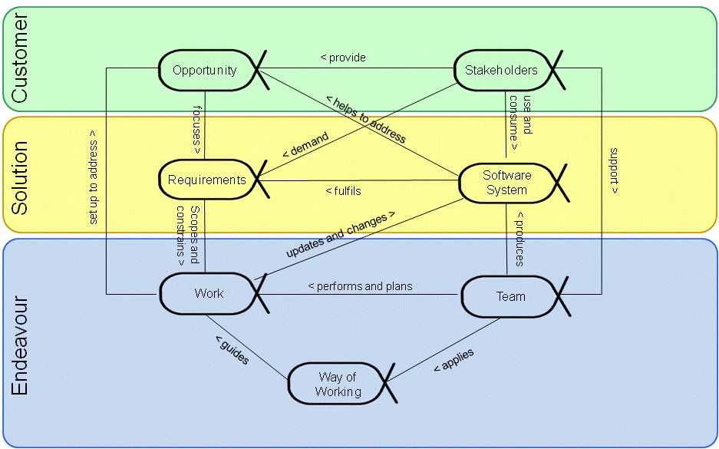
Add Essential “things to work with” – Alpha’s
Notes:
Take any of these away and it gets out of control

Slide 18
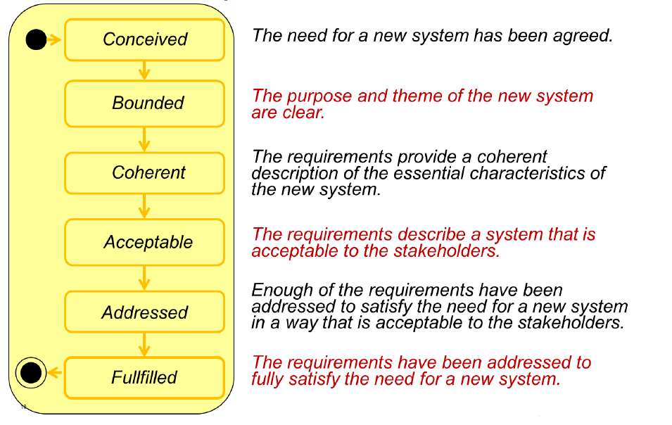
Requirements Alpha States
This is not suggesting a waterfall approach to requirements, indeed could describe an iteration, each requirements goes through these states.
It does not specify how
It does not specify what requirements are.
These states are essential

Slide 19
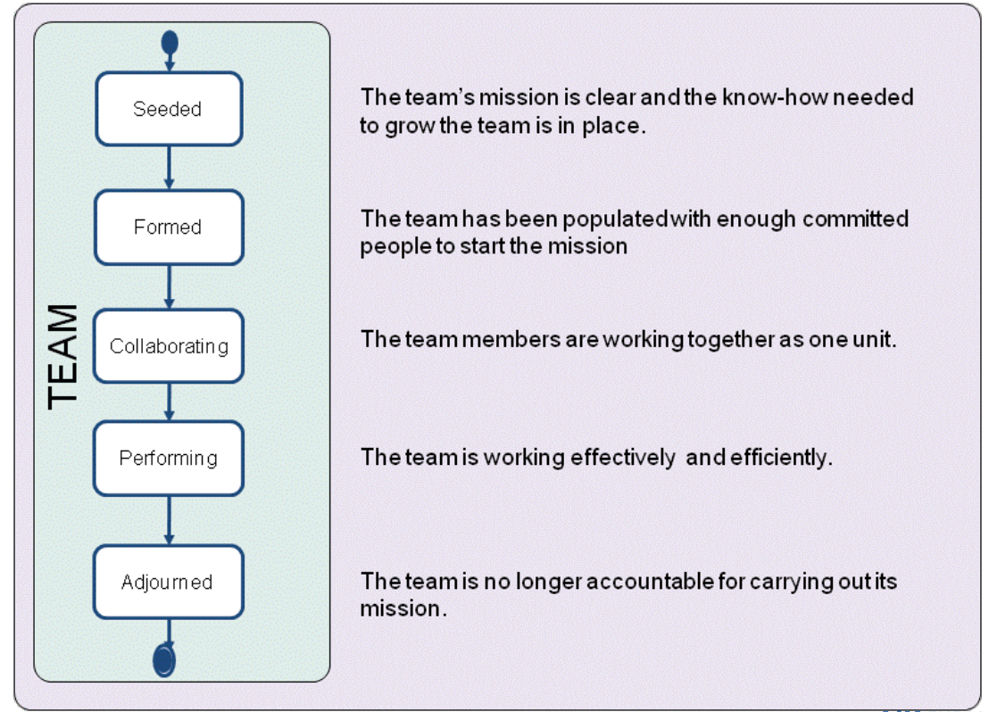
Team Alpha States

Slide 20
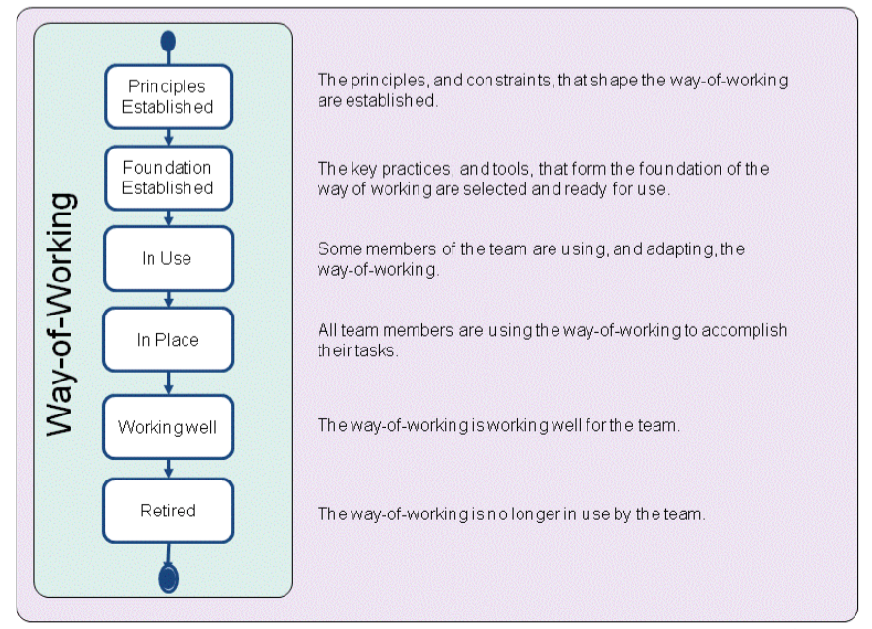
Way Of Working Alpha States

Slide 21
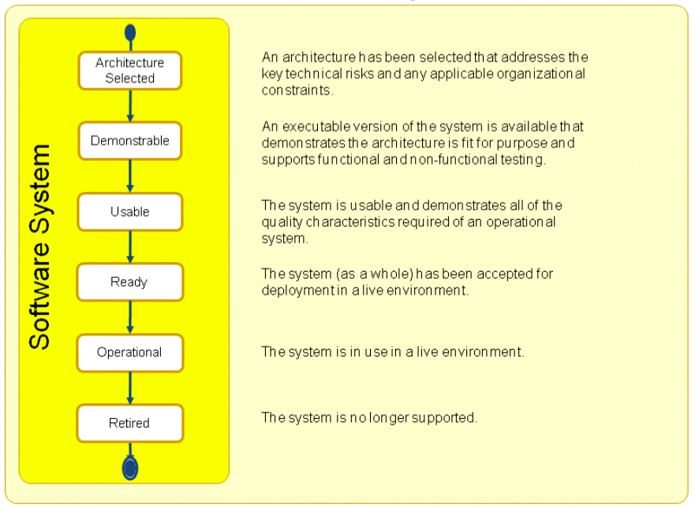
Software System Alpha States

Slide 22
Flight Checklists – consider the state: Before-Takeoff
Segmented checklists are constructed so that specific segments are completed at appropriate times.
Initial Items
Auxiliary fuel pump — Off
Flight controls — Free and correct
Instruments and radios — Checked and set
Landing gear position lights — Checked
Altimeter — Set
Directional gyro — Set
Fuel gauges — Checked
Trim — Set
Propeller — Exercise
Magnetos — Checked
Engine idle — checked
Flaps — As required
Seat belts/shoulder harnesses — Fastened
Parking brake — Off
Final items
Doors and windows — Locked
Mixture — Full rich unless above 3,000 feet msl
Lights — Landing, taxi, strobes on
Camera — Transponder on
Action — Engine instruments checked
Notes:
Traditionally, written checklists are designed to be carried out from beginning to end all at once. Segmented checklists, however, are constructed so that specific segments are completed at appropriate times.
After take off there is another check list to land, you are in a different state.

Slide 23
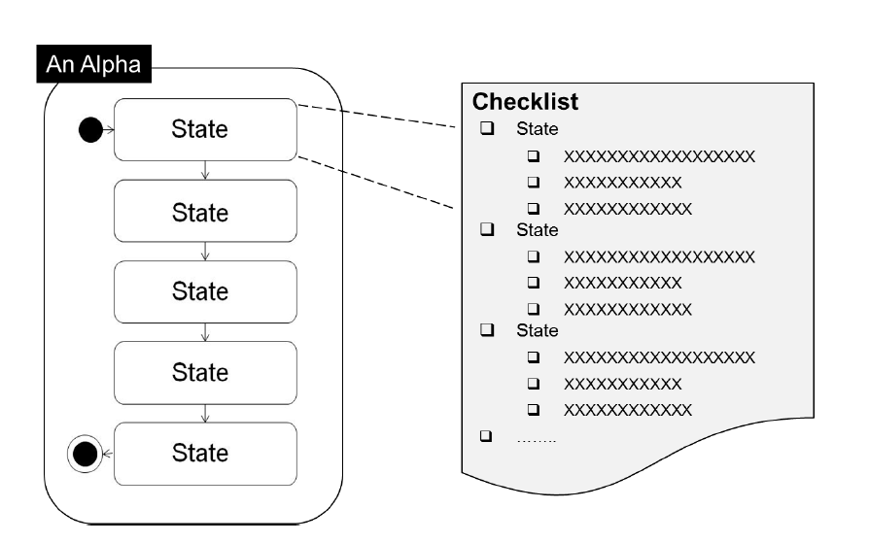
Structure of an ALPHA
An Alpha has State and is simply managed with Check Lists
Alpha = Abstract Level Progress Health Attribute
State monitors:
Progress – where are we up to
Health – is State where we should be, or we are blocked
An Alpha does not tell you how to get from State to State

Slide 24
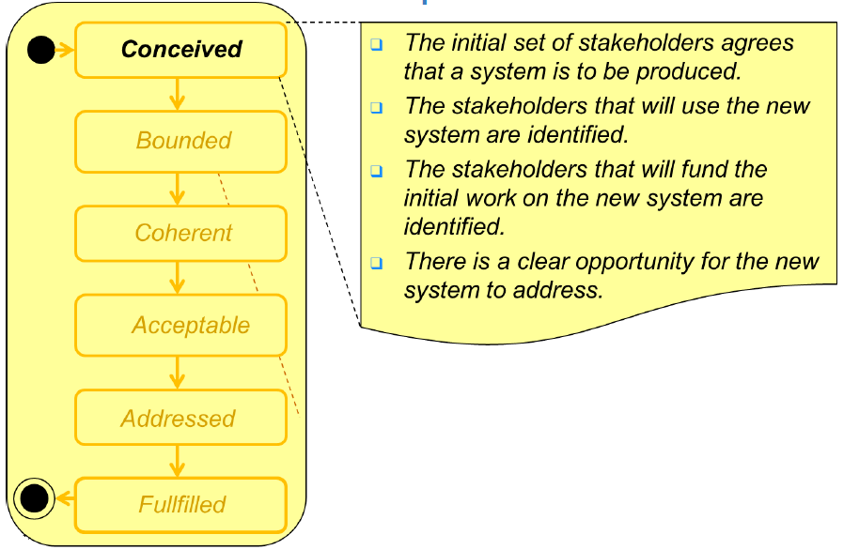
Each State has a Check List, completed to transition the state

Slide 25
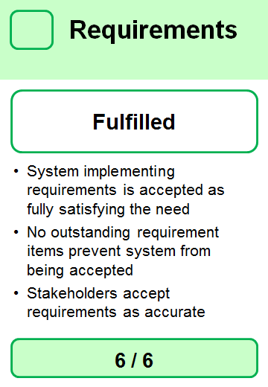
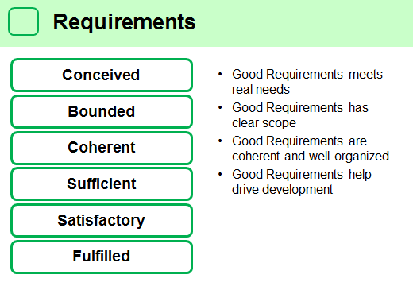
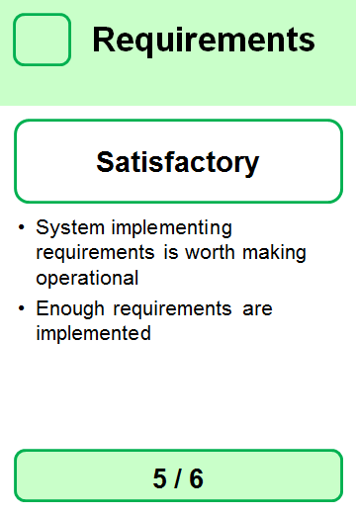
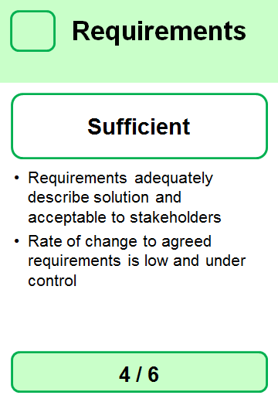
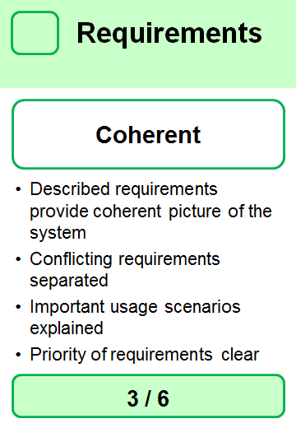
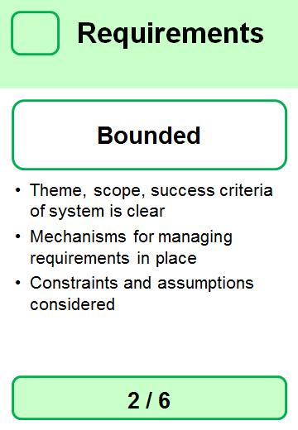
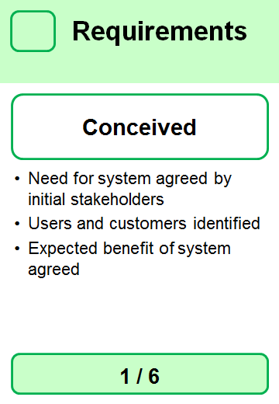
Descriptive tool: Cards and Checklist
Explanation Card for each State
Simple Guidelines
States
Each state defines an extensible check list.
Monitor progress to goal state
Work moves items through states. For example, the goal of building a system is to get “Conceived” Requirements to a “Fulfilled” state, by executing Work, by the Team, to deliver an “Operational” Software System. We are interested in monitoring these items to plan work. The next page shows how some of these items move from state to state.
Notes:
Each Card (Alpha) is independent, so adding check list items, or cards, does not result in entanglement and dependencies.
Cards are created and managed with Essence Tool
We can create new or edit Alphas, states, and checklist items.

Slide 26
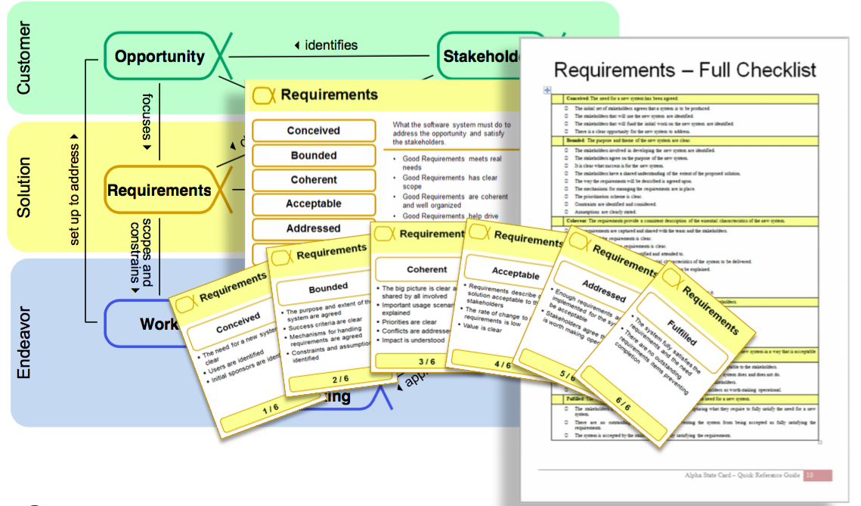
Kernel is Practical – Cards and Checklists are Physical

Slide 27
Practical use

Slide 28
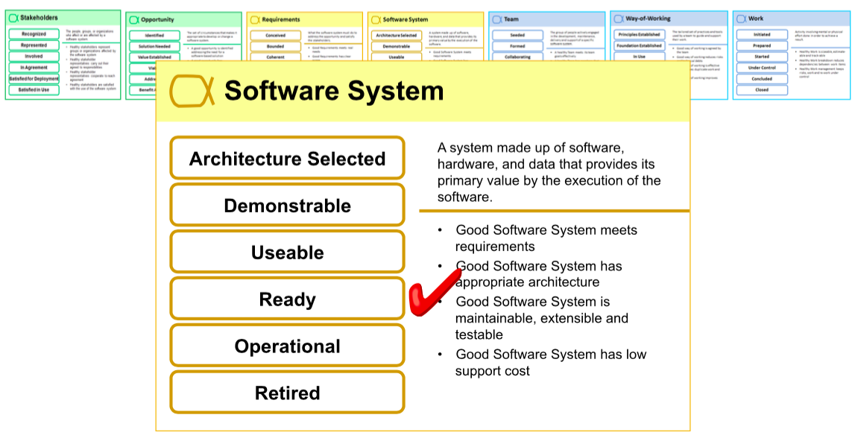
How do you use the Alpha cards ?
Where do we think we are up to (what state are we in ?):
Lay Cards Out
Play Poker
Help work out what’s Next.
Retro’s & Reviews: Focus on Pain Points – find the root cause of challenges

Slide 29
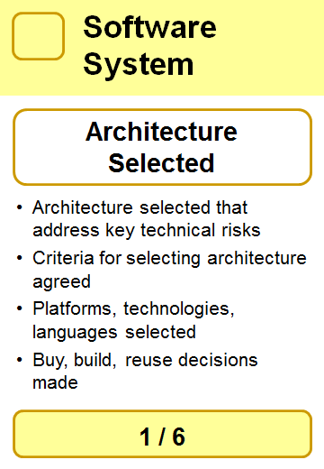
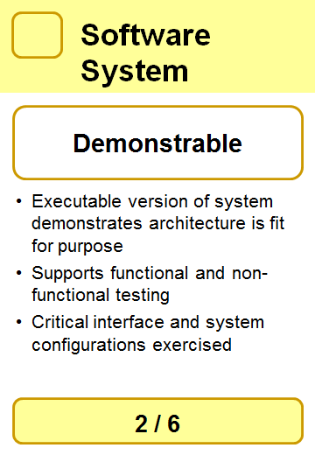
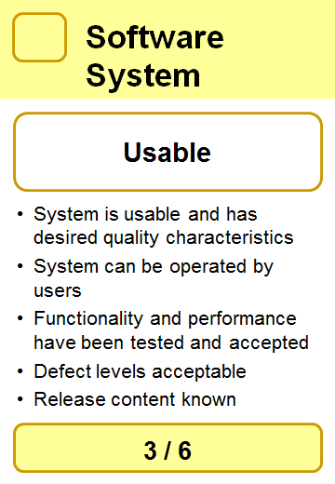
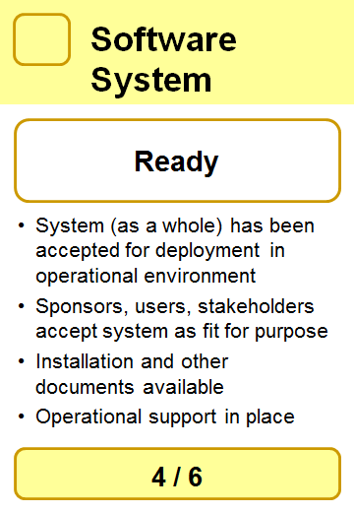
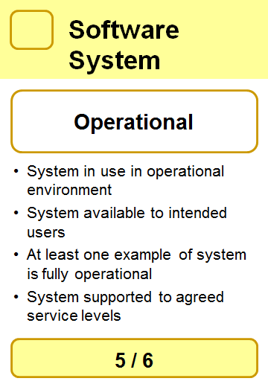
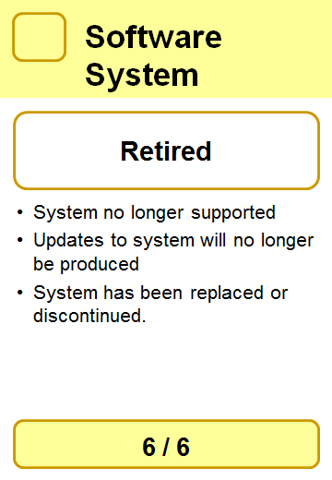
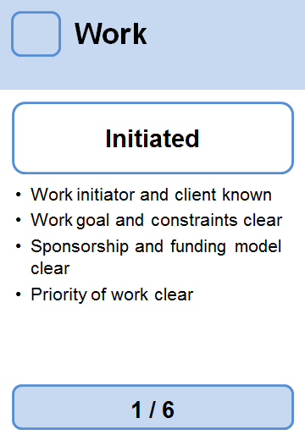
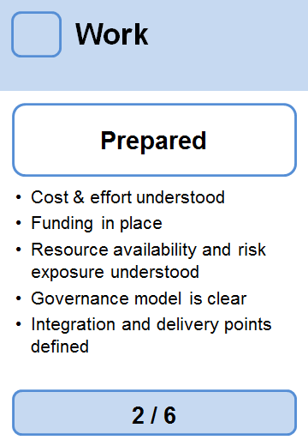
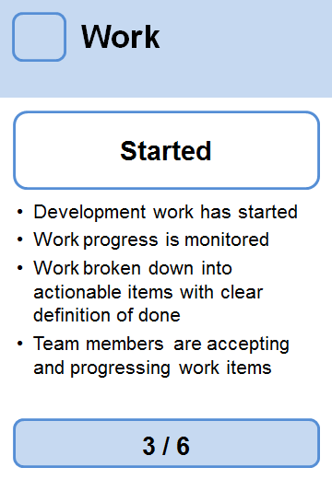
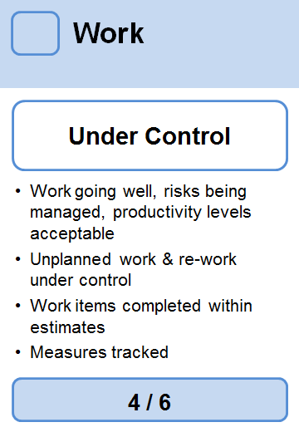
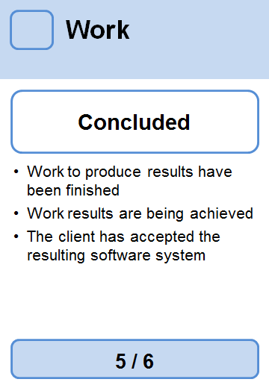
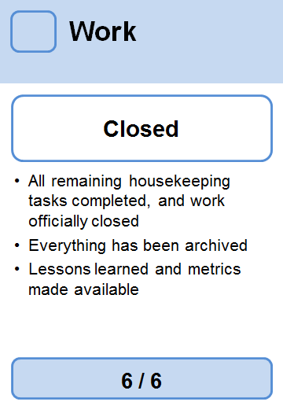
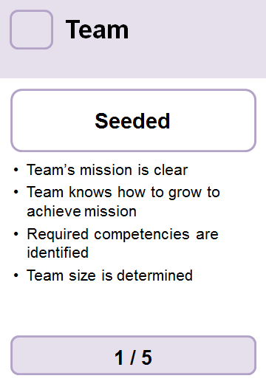
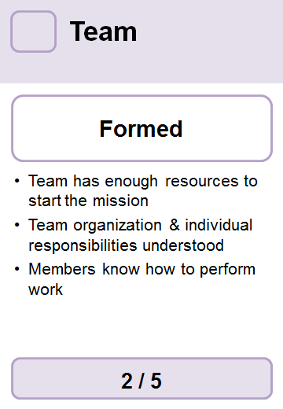
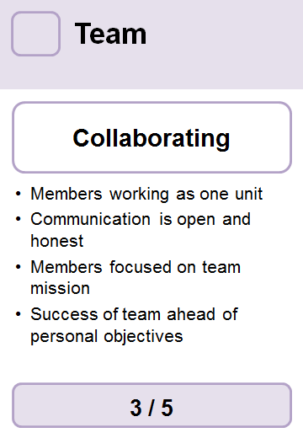
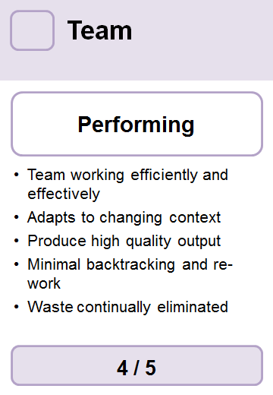
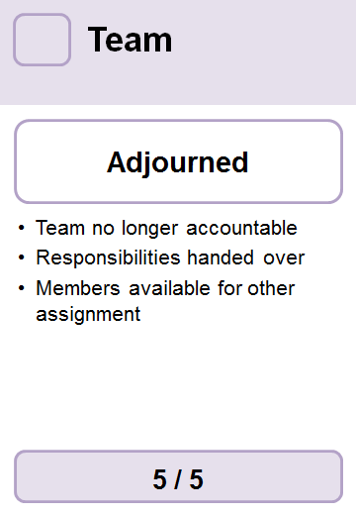
What is our Current State ?
requirements
software system
work
team

Slide 30
What is Completed; What is pending ?
Completed
Pending

Slide 31
We are Here – Is it healthy; What’s next ?

Slide 32
Kernel is Actionable: How to achieve Next State ?
These are our Objectives for next Iteration.
For each, we can define the tasks required to complete or progress the Alpha State.

Slide 33
Drive Iterative Development

Slide 34
Task Backlog – Start (what we are achieving and how)
Objectives
To Do
Doing
Done
Task 1
Complete Requirement Item 5 - Satisfactory
Bill
Task 2
Complete Requirement Item 9 - Satisfactory
Fred
Task 3
Implement Requirement Item 5
John
Task 4
Implement Requirement Item 9
Bill
Task 5
Release MVP 0.1 to production – Usable System
Dan
Backlog

Slide 35
Task Backlog – A week later - In Progress
Objectives
To Do
Doing
Done
Task 1
Bill
Task 2
Fred
Task 3
John
Task 4
Bill
Task 5
Dan

Slide 36
Retro’s

Slide 37
Plan-Do-Check-Adapt Cycle (Demming Cycle)
Determine:
Current state
Next state, the goal
How to achieve next state, what is ‘Done’
Reflect on what happened
Improve:
the way of working
the quality of work
Reduce waste
Adapt
Plan
Do
Check
Track the Work in the Iteration.
What’s the state ?
Check the work is ‘Done’
Work to achieve the next state, the increment
Remove blockers as they occur

Slide 38
Retrospective – Inspect and Adapt
The Toyota Way defines 2 important practices:
‘Kaizen’ or continuous relentless process improvement. Become a learning organisation.
Thinking before doing; planning up front (just enough) but responding to change. A little thought can avoid a lot of doing and re-doing.
When we finish an iteration we inspect, reflect and improve, while the experiences are fresh in the team's mind, before starting the next iteration. If we must fix an issue, we may stop the line, ‘Andon’, until resolved. This is a time to review our beliefs, assumptions and values.
What is discussed:
What worked well, what we liked ?
What did not go well ?
What can be done better ?

Slide 39
Change the focus of Retro – make it tangible with Alphas
What worked well, what we liked ?
What did not go well?
What ca be done better?
What worked well, with our planning, doing, and checking related to the previous alpha states ?
What did not go well, with our planning, doing, and checking related to the previous alpha states ?
What cane we do better, with our planning, doing, and checking related to the previous alpha states ?

Slide 40
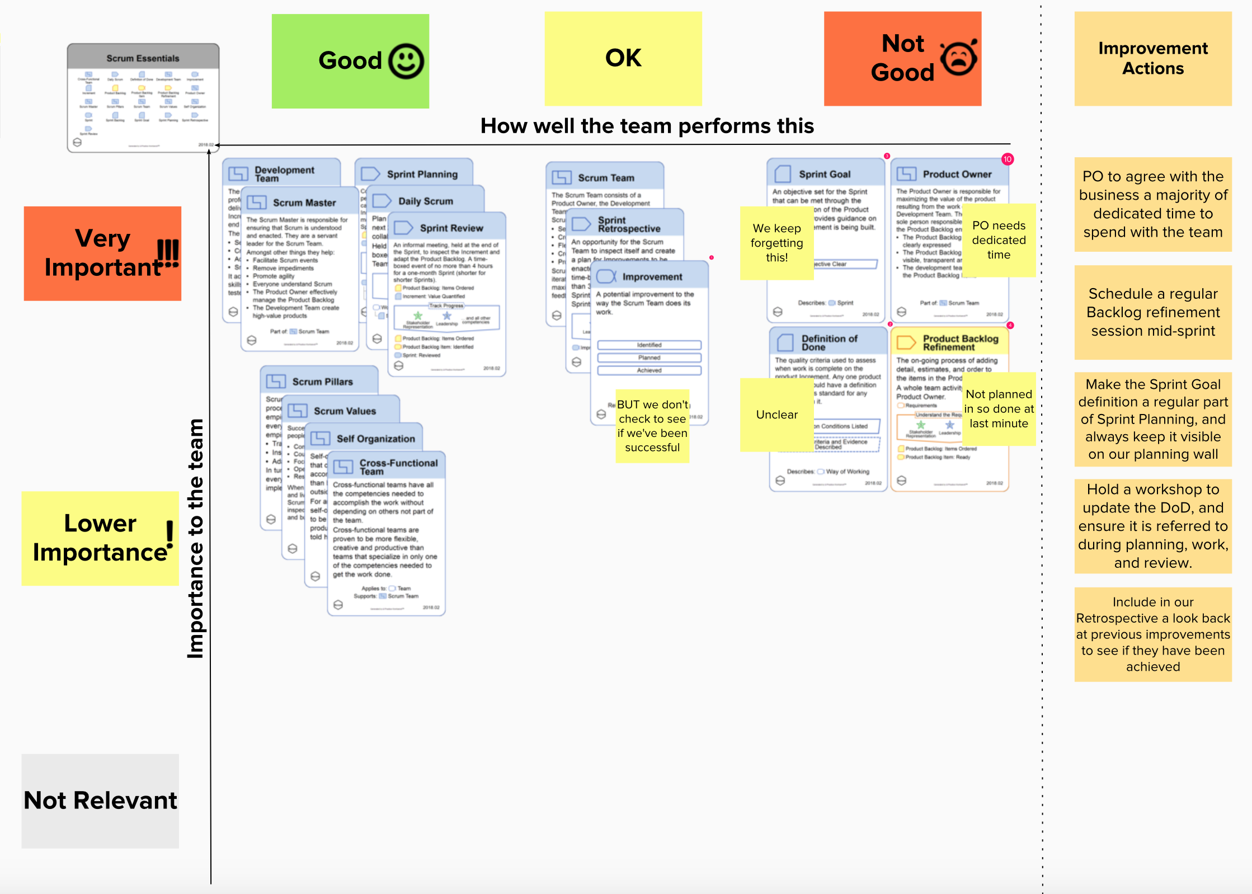
Using the SCRUM Cards to Explain

Slide 41
Review where we are at

Slide 42
Exercise
Lets review a current project.
We are going to move the Alpha sliders to determine where we are at.

Slide 43
Project Review Sliders
Customer
Solution
Endeavor
Stakeholders
Opportunity
Requirements
Software System
Work
Team
Way Of Working
Recognised
Identified
Architecture Selected
Principles Established
Initiated
Solution Needed
Foundation Established
Prepared
Where we are
Started
In Use
Value Established
Conceived
Demonstrable
Seeded
Represented
Under Control
Formed
Bounded
Involved
Collaborating
Where we want to go next
In Agreement
Coherent
Usable
Performing
Viable
Acceptable
Ready
In Place
Satisfied For Deployment
Addressed
Addressed
Concluded
Working Well
Operational
Satisfied in Use
Benefit Accrued
Fulfilled
Retired
Closed
Adjourned
Retired

Slide 44
Organise Lifecycles

Slide 45
A method may have a defined Lifecycle by Phases or Gates
Agile has no Lifecylce Phases or Gates
Adapt
Plan
Do
Check
Adapt
Plan
Do
Check
Adapt
Plan
Do
Check
Adapt
Plan
Do
Check
Waterfall
Analysis
Requirements
Design
Dev
Test
Deploy
Maintain
RUP
Inception
Elaboration
Construction
Transition

Slide 46
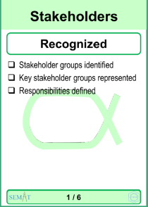
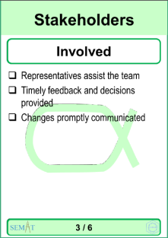
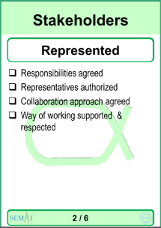
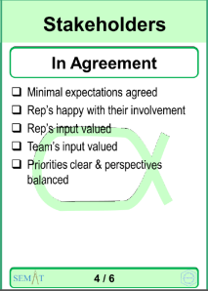
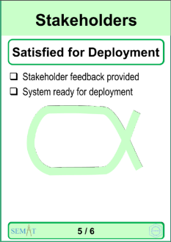
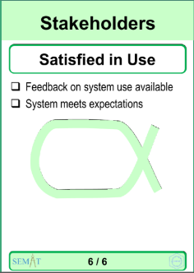
What about Governance Gates / Phases – another with milestones
Inception
Elaborate / Develop
Transition
Decision to Fund
Usable System Available
Develop Business Case
Skinny System Available
Decision to Go Live

Slide 47
Alphas are great - but there’s more !

Slide 48
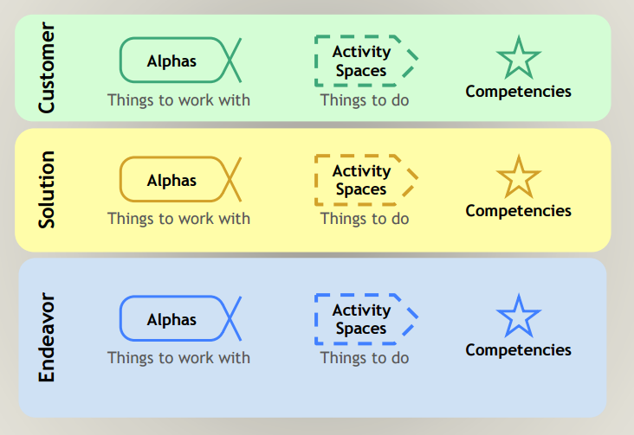
Essence Kernel

Slide 49
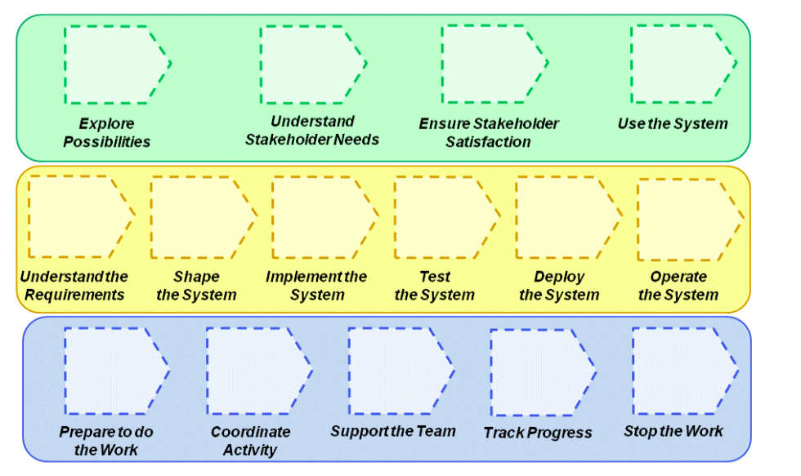
Core Elements – Activity Spaces: Placeholders for Activities
Customer
Practices will place Activities in the Activity Spaces.
Solution
Endeavuor
Note: there is no left to right implied order, this is not a process description.

Slide 50
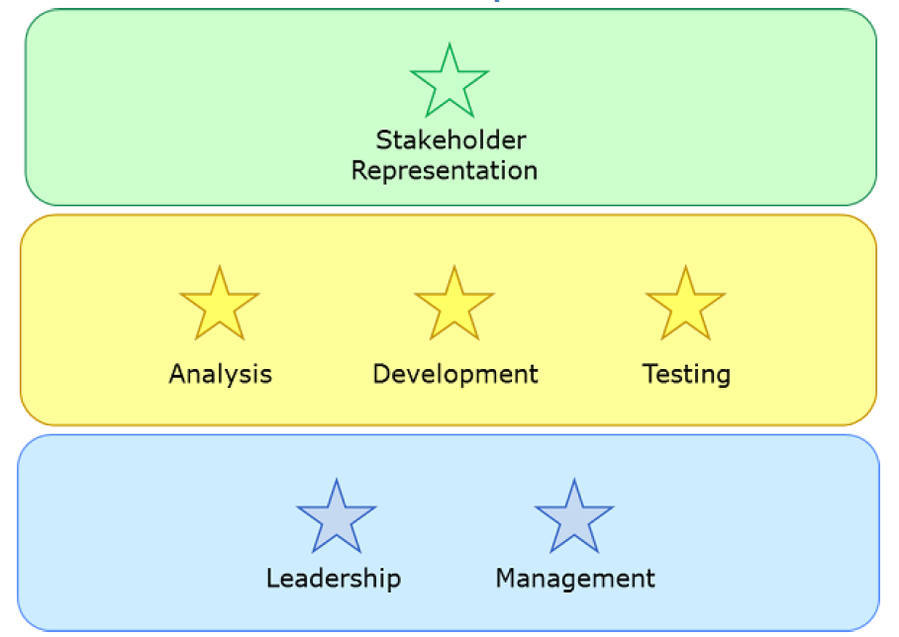
3 Core Competencies in Kernel
Customer
Solution
Endeavuor

Slide 51
Practices and Agile Essentials

Slide 52
Practices
Although ‘Practice’ is a commonly used term, it is at best loosely defined; and there are many ways to define a practice…...
The Kernal provides a simple language to precisely describe practices, in terms of:
Things to Work With:
Alphas described by
Work Products
Things to Do:
Activity Spaces refined by
Activities
The Kernel language also provides a way to understand how practices work together through Practice Composition. This is about merging practices together, and sorting out the overlap:
Kernel is separated from Practices
Alphas are separated from Work Products (documents)
Essence is separate form the details

Slide 53
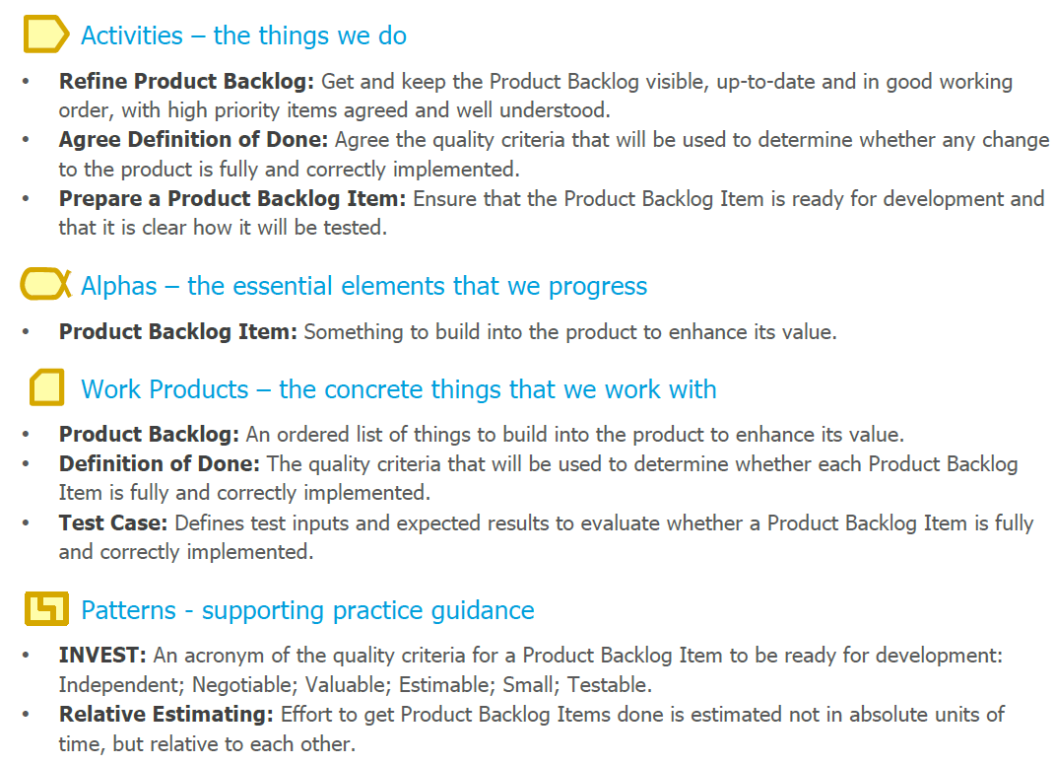
Example “Product Backlog Essentials” Practise

Slide 54
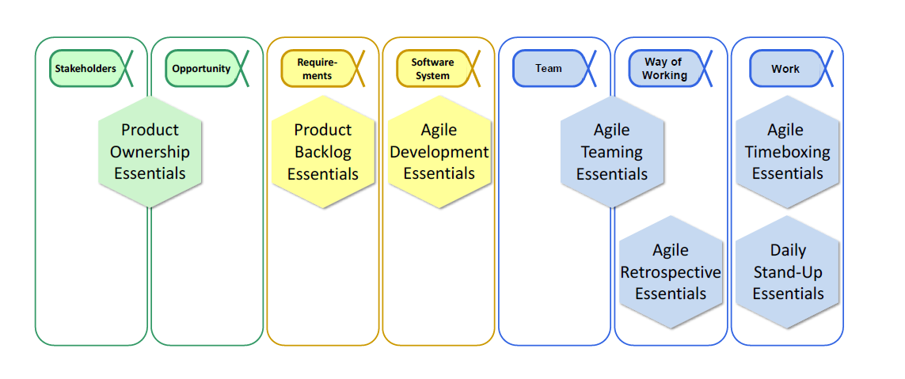
Extending the Kernel – Add the ‘Agile Essential Practices’
Adding Practices on top of the Kernel creates a specific Method.
For example, an Agile method with 7 practices.
Notes:
Practices can involve multiple Alphas.

Slide 55
Agile Essentials Practises
Product Ownership Essentials - own, evolve and communicate the product vision and guide the evolution of the product to achieve the vision
Product Backlog Essentials - capture what the users of a software system want it to do as a priority-ranked list of independently buildable items
Agile Teaming Essentials - a self-organizing team maximizes its performance by using a highly collaborative teaming approach
Daily Stand-up Essentials - use a short, daily, whole-team meeting to reaffirm delivery focus, assess progress, agree work plans and action the removal of impediments to progress
Agile Development Essentials - add value to a product by incrementally extending it while ensuring it remains usable, releasable and maintainable
Agile Retrospective Essentials - make incremental improvements to the way of working through regularly repeated retrospectives
Agile Timeboxing Essentials - progress the work as a series of focused timeboxes, and assess and re-plan the work at the end of each timebox.

Slide 56
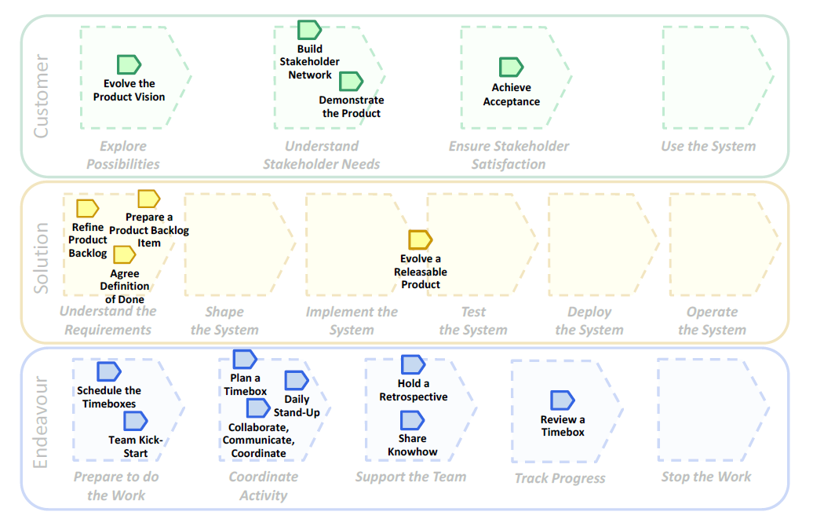
Agile Essentials – Activities on their Kernel Spaces

Slide 57
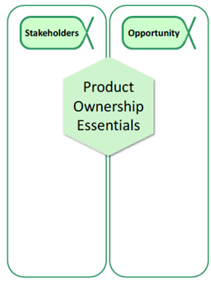
Customer Related Practise, Alphas and Activities

Slide 58

Solution Related Practise, Alphas and Activities

Slide 59

Endeavour Related Practise, Alphas and Activities

Slide 60

Architecture Essentials
Explore the Web Output of Tooling

Slide 61

Web Descriptions

Slide 62






Coaching Competency

Slide 63
Extensibility and Evolvability
The Kernel supports evolutionary change, that is, a team can evolve their way of working as they go.
Zoom In
Provide more specific guidance to novice and large teams with explicit practices
Kernel
Reach Out
Meet the needs of different kinds of development through the use of appropriate practices
Scale Up
Facilitate coordination, planning, and tracking when conducting large software development endeavors
Notes:
Supports evolutionary change, that is a team can evolve ther way of working as they go.

Slide 64
Conclusion
Process / Method Agnostic
Provides a Kernel that is universal, that
focuses on progress and health
is actionable
Start Simple and Extend
New User Experience
Simple Card / Checklist Approach.
Many ways to apply:
Review and understand progress.
Health Check.
Focus and Resolve Pain points.
Team Reflection.
Build as much method as you need:
Experience of Team
Governance,
Formality
Practise Based
Practises are extensible, and composable
Mix and Match to make own Method
Large library of practices, and extensions
Tooling to support Teams
Kernel
Actionable
Extensible
Practical
Notes:
Actionable -> the states guide you to where next

Slide 65
The End

Slide 66



Types of ESENSE
Lite
Kernel
Plus

